Slide 1
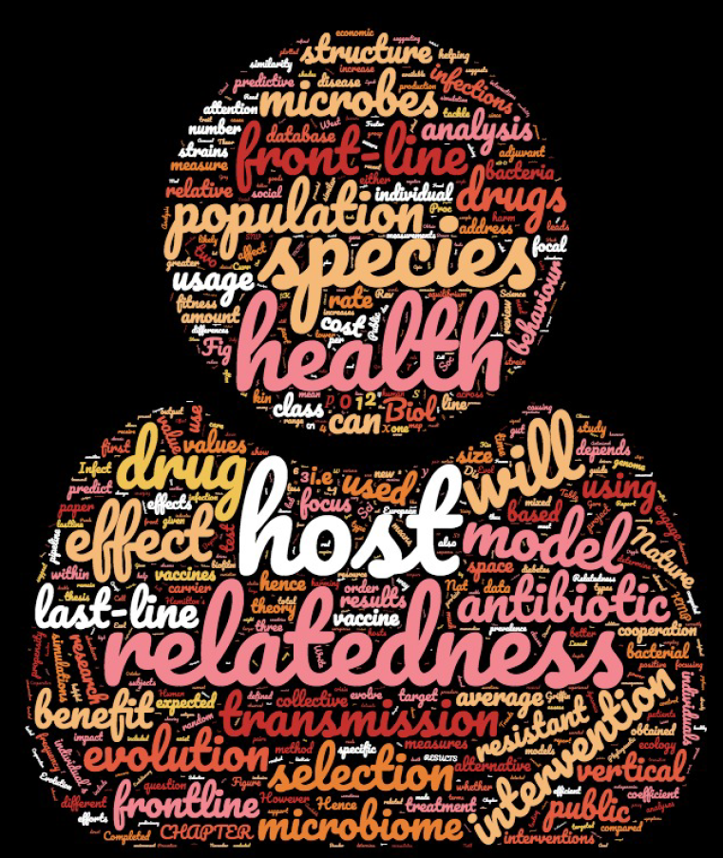
Evolutionary microbiology to improve Human health
Camille Simonet
McNally Lab
Camille Simonet
Epigroup meeting
16/10/2019

Slide 2
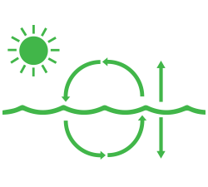


Understanding microbial communities dynamics
Which mechanisms do play a significant role in those dynamics?
Which mechanisms are of general importance?
→ Gain a predictive understanding
Notes:
Managing highly complex and dynamic microbial communities is releavant to a considerable range of applications including food production, bioremediation or gut-related disease treatement.
It remains a key challenge to identify which mechanisms do play a significant role in those communities dynamics to gain a predictive understanding of it
Which mechanisms should we include in our predictive models to capture the wealth of descriptive empirical data?
Which mechanisms are of general importance?

Slide 3
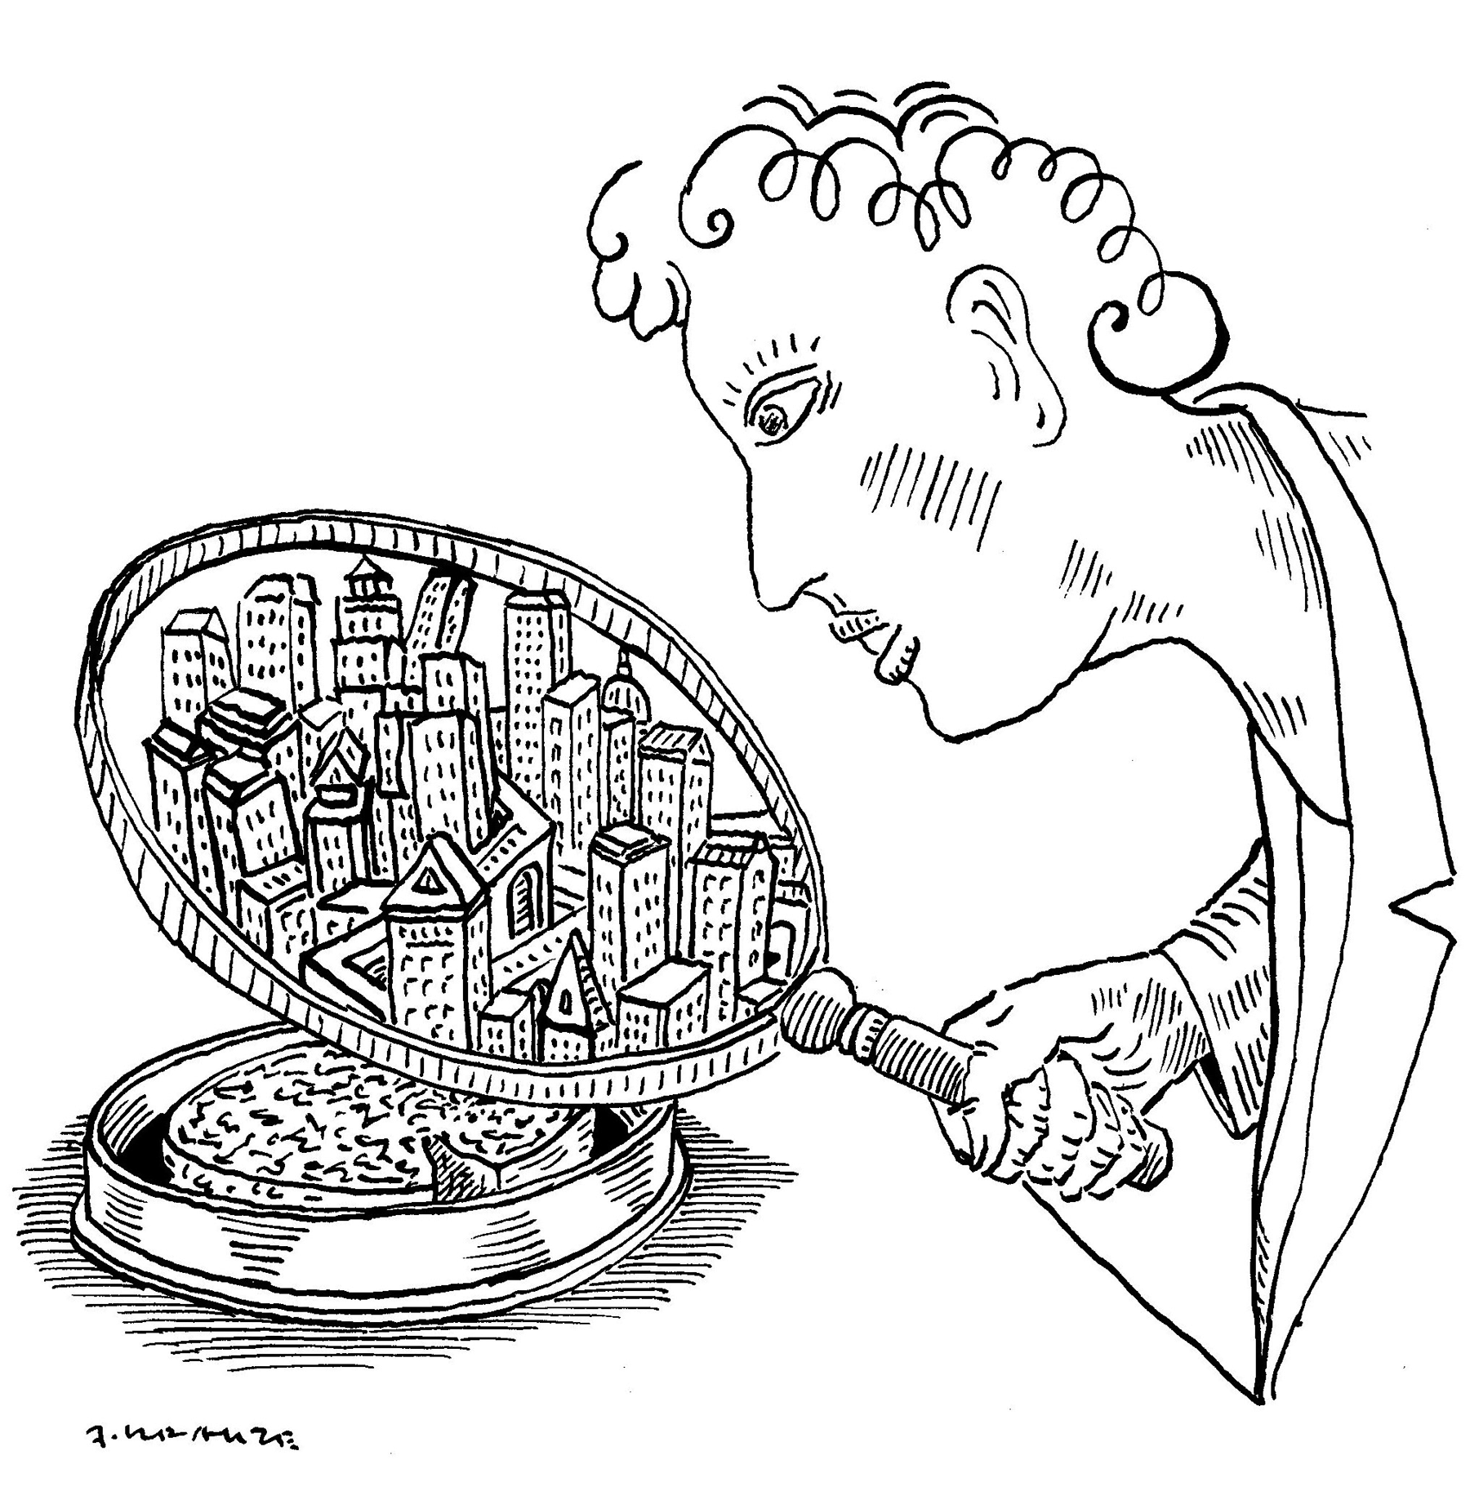
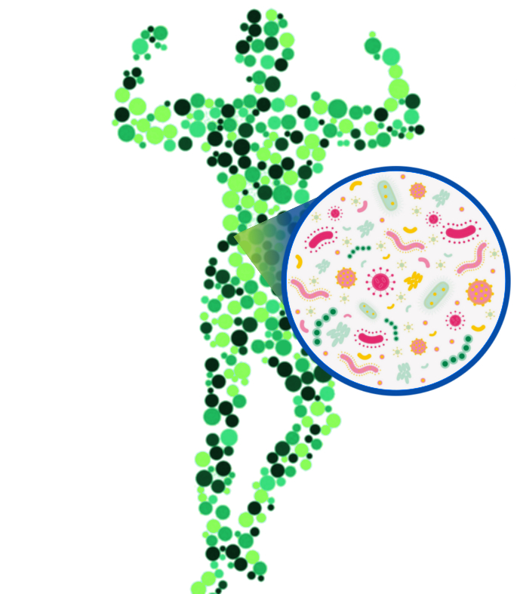

Making a practical use of evolutionary theory
Using evolutionary insights/principles to better inform public health policy and biomedical research
Mathematics + statistics + bioinformatics
Cooperation in real-world microbial communities
Social evolution theory, microbiome & host health
Models and data to devise strategies against AMR

Slide 4
Cooperation in real-world microbial communities

Slide 5
Start with cooperation
Notes:
Ultimately, microbial communities’ dynamic will depend on the range of behaviours microbes engage in and their strategy to face competition ¹¹. It is widely documented that many of these strategies involve cooperative interactions ^{12–15}.

Slide 6



Public goods in bacteria
Biofilm
Quorum sensing
Cooperative ABR
Let’s wait until we are enough to attack. Start counting!
Notes:
These include for example cooperative feeding via the secretion of nutrients and digestive enzymes ^{16–18} coordinated response via signalling molecules ¹⁹ or communal habitat building using surface proteins and polymers for biofilms formation ²⁰. The importance of such cooperative behaviours in microbial functions has long been suggested ²¹ and the use of “omics” approaches to study microbial communities has recently demonstrated this in real microbial communities ^{22–24}.

Slide 7
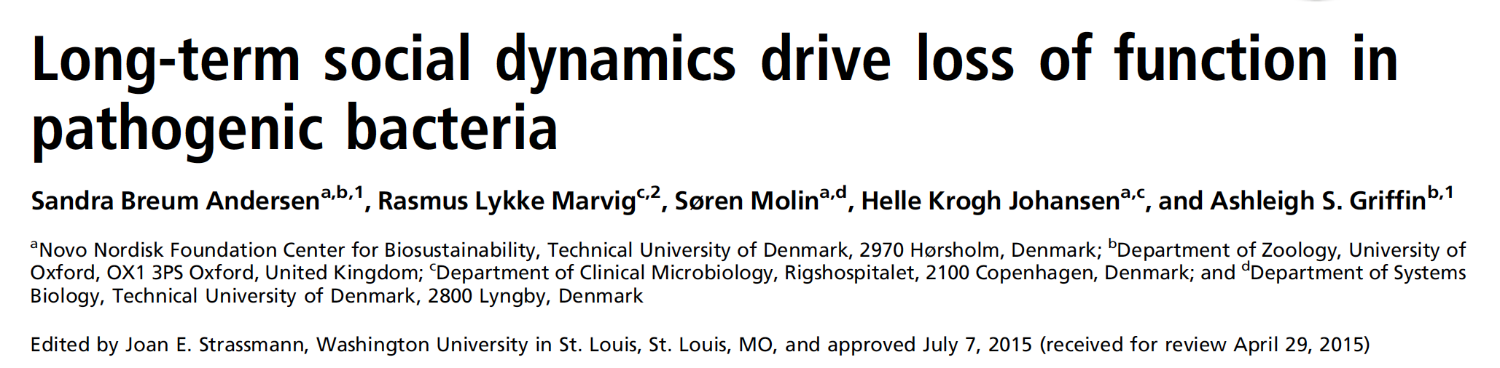
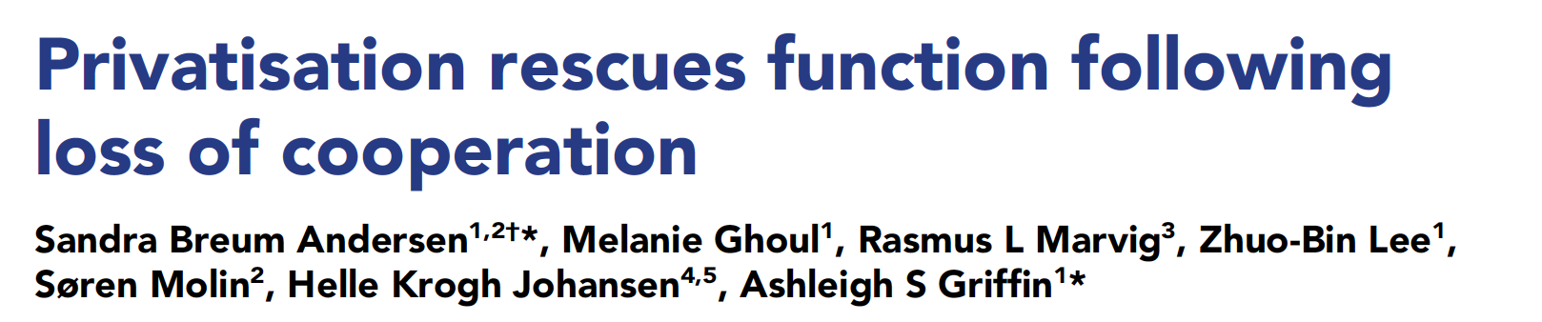
Cooperation is a key aspect of bacteria lives
(PNAS, 2015)
(eLIFE, 2018)

Slide 8
The evolution of cooperation is puzzling
Notes:
- This means that a sensitive cells should be able to invade a population of resistant cells
- Cooperative behaviour should disappear due to their exploitation by cheaters
- This rises a common question in evolutionary theory, addressing “how cooperation can be maintained”
- This has been observed many time experimentally
- In the context of ABR, this means that this type of resistance should be difficult to maintain and spread
But still, this is one of the most commonly observed mechanism of resistance

Slide 9
The evolution of cooperation is puzzling
= Resistant
Cheaters take over
= Sensitive
Notes:
- This means that a sensitive cells should be able to invade a population of resistant cells
- Cooperative behaviour should disappear due to their exploitation by cheaters
- This rises a common question in evolutionary theory, addressing “how cooperation can be maintained”
- This has been observed many time experimentally
- In the context of ABR, this means that this type of resistance should be difficult to maintain and spread
But still, this is one of the most commonly observed mechanism of resistance

Slide 10
Resolving the dilemma: inclusive fitness theory
Population genetic structure
A
A
Vs.
“Indirect fitness benefits”
“direct cost”
Collective behaviours evolve
AA
AAAA
= relatedness
Hamilton’s Rule: Rb > c
Notes:
The central role of genetic relatedness between the focal individual and the recipient comes from the fact that an individual can not only increase the transmission of its genes directly, by enhancing its own survival and reproduction, but also indirectly, by enhancing the reproduction of individuals carrying the same genes, i.e., genetically related individuals ^{1,26} (Fig. 1a).
Therefore, the theory developed by Hamilton has a simple testable prediction: the assortment of genotypes in the population -that is, increased relatedness- should lead to more cooperation. In the perspective of building a predictive understanding of microbial communities’ dynamics, this suggests that the assortment of cells in the population -and ultimately the ecological factors driving this assortment- is a key driving variable.

Slide 11


Simple testable prediction:
increased relatedness = increased cooperation
Relevance for to understand & manipulate microbes
Vivid criticism & ongoing debate
Does relatedness play a significant role in the real world?
Does it have predictive power?
Notes:
We argue that, if the purpose is to improve our understanding of the natural world, the question is that of the general importance of relatedness in organism’s evolutionary history. Does it play a significant role in the real world or is it instead overcome by other mechanisms? This is particularly relevant to the challenge of predicting microbial communities’ complex dynamics. Genetic relatedness offers a simple population genetics parameter which, as we show in this study, can now be precisely measured using sequencing metagenomic data. If relatedness is generally predictive of the evolution of cooperative behaviours in microbes, it offers an actionable tool to predict microbial communities’ functions.

Slide 12

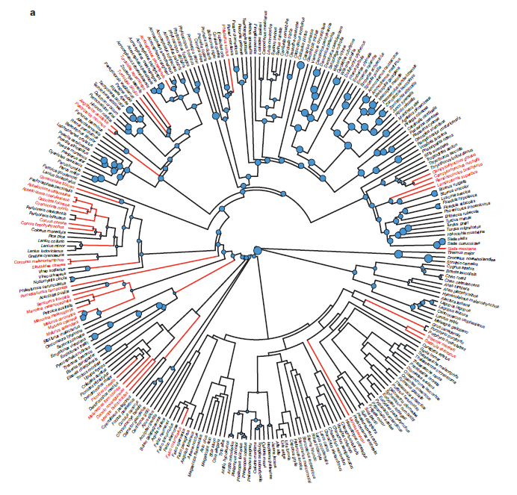
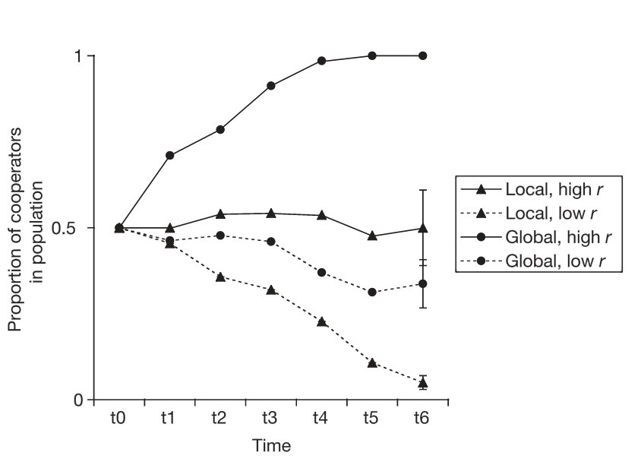
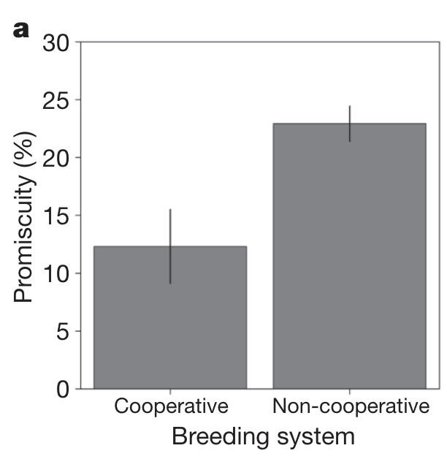

How to test the predictive power of relatedness?
Manipulate relatedness in the lab
Comparative analysis
Do it in microbes!
Real world is not that ‘clean’
Limited number of behavior
Limited number of species
Proxy of relatedness
Griffin et al. 2004; Cornwallis et al. 2010

Slide 13
Carry out a comparative analysis in gut microbes
Notes:
Here we address all of these shortcomings by carrying out a phylogenetic comparative analysis across the full diversity of the human gut microbiota, encompassing 38 genera, using six different kinds of cooperative behaviour. This allows us to test the claim of the generality of relatedness' predictive power, assessing it over a broad set of ecological idiosyncrasies by (i) including a large number of phylogenetically distant species with different ecologies, (ii) comparing a variety of cooperative behaviours that have very different ecological contexts and (iii) using real genomic relatedness, measured in a consistent way across all the species. That is, it allows us to ask for the predictive power of relatedness, averaging over potential breaks of assumptions or particular behaviours and ecologies that do not conform to the theory’s predictions.

Slide 14





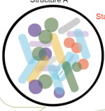


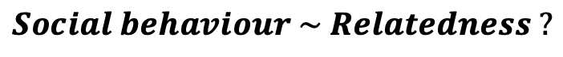
Carry out a comparative analysis in gut microbes
Social behaviour
Relatedness
‘Real world’ data:
Phylogenetic mixed model
Human gut metagenomes
$$Social behaviour \sim Relatedness ?$$

Slide 15
Step 1: measuring relatedness
MIDAS – Nayfach et al, 2016
SNPs detection to resolve strain level composition

Slide 16
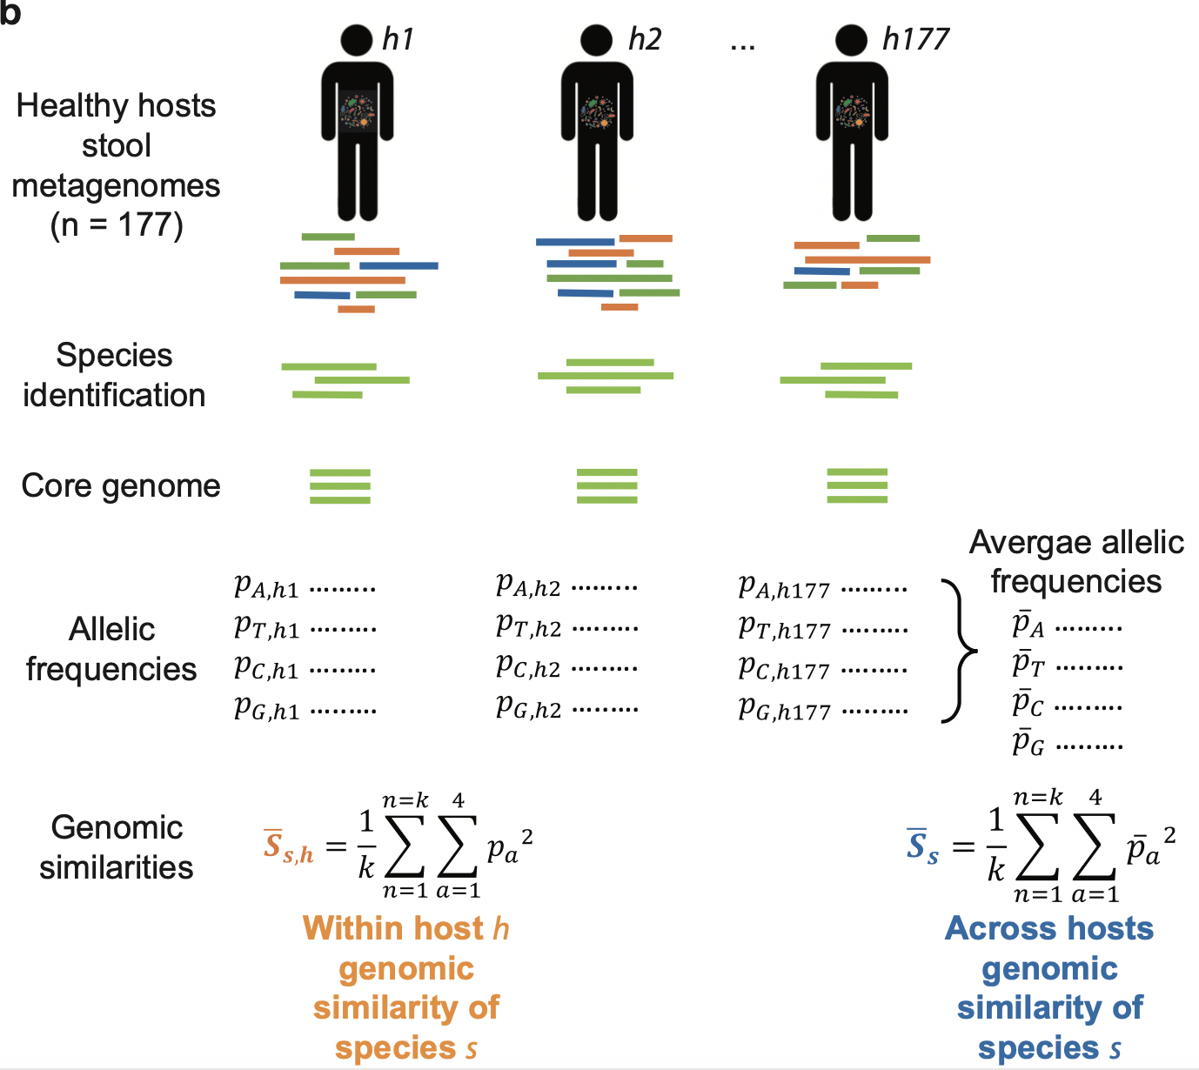
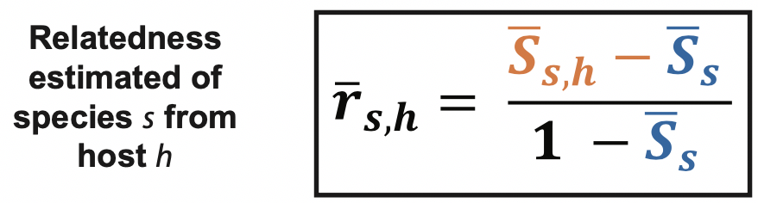
SNP calling
Notes:
Our measure captures an excess of similarity within the host compared to the overall bacterial population diversity (across all hosts), in a similar fashion as F_{ST} relates local to global diversity.

Slide 17
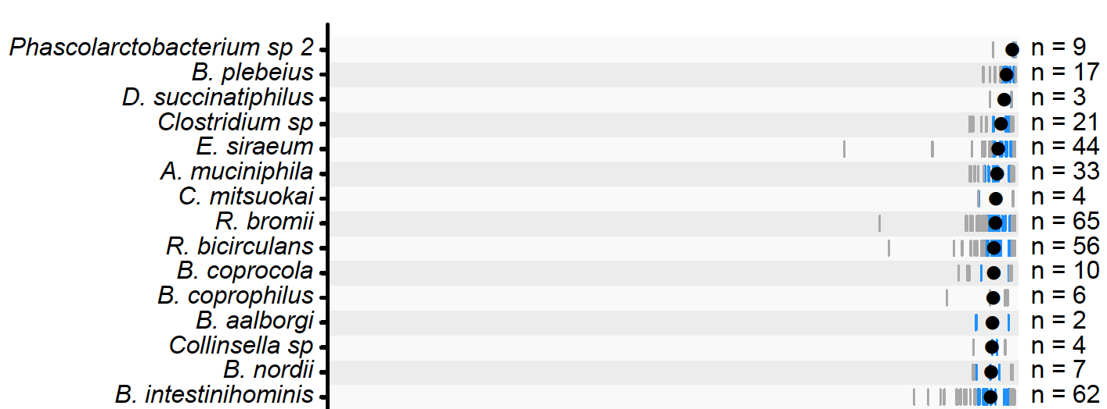

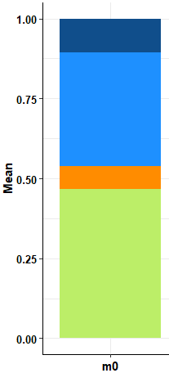

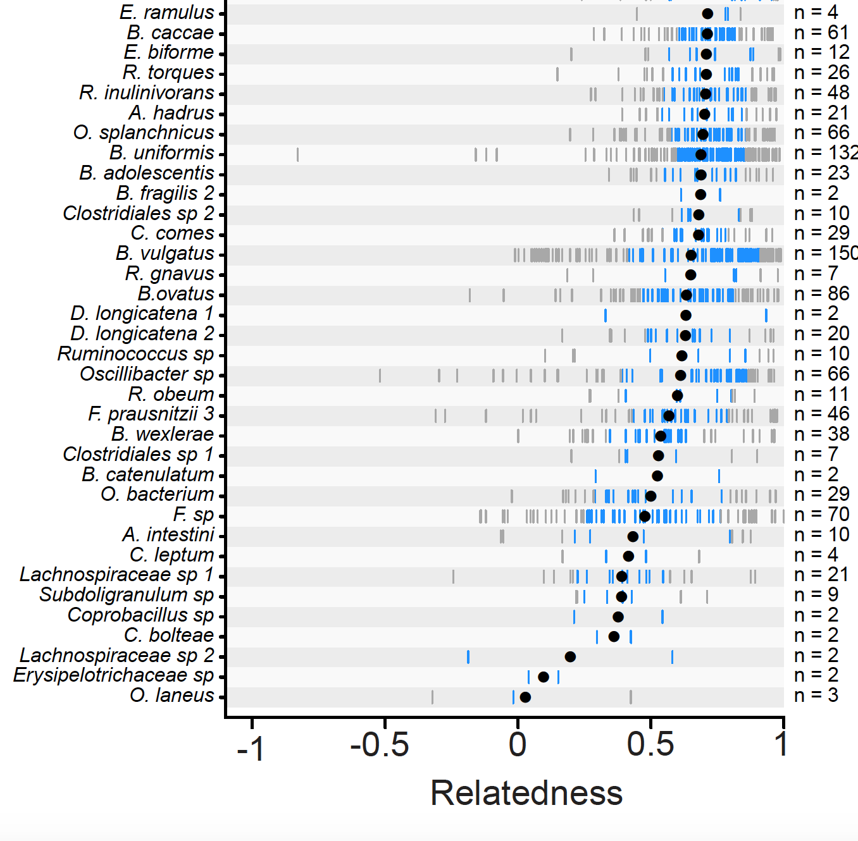
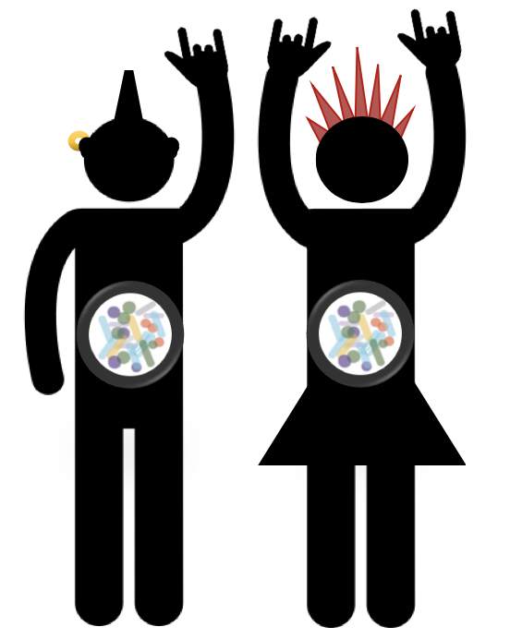

Explained
Idiosyncratic
Notes:
We obtained estimates of relatedness for all observed host-species pairs and find that the vast majority of the gut microbiome species (>90% of the species included in this analysis) have an average relatedness greater than 0.5 (Fig. 1c), meaning that for most gut microbiota species the conspecifics they interact with within their host are at least as related as siblings in sexually reproducing species. Approximately 50% of the variance was explained by species, while only a small fraction was explained by host (Bayesian phylogenetic mixed model: species total effect -sum of phylogenetic and non-phylogenetic effects- posterior mode = 0.50, CI₉₅ = 0.34, 0.60; host effect posterior mode = 0.06, CI₉₅= 0.04, 0.1) (Fig. 1d, extended data figure 1, extended data table 1 ). This shows that within-host genetic relatedness is a repeatable aspect of a gut microbiota species’ ecology, making it suitable for use in comparative analysis.

Slide 18
Step 2: measure sociality from genome content
1 - Computational: secretome size
Notes:
We assessed a microbe’s propensity for cooperation from their genome content

Slide 19
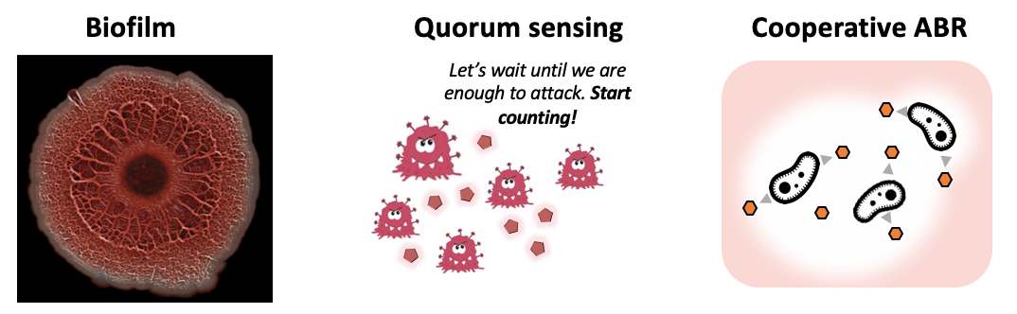
Step 2: measure sociality from genome content
1 - Computational: secretome size
Public goods
=
SECRETED PRODUCTS
Notes:
We assessed a microbe’s propensity for cooperation from their genome content

Slide 20
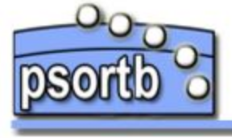
Step 2: measure sociality from genome content
1 - Computational: secretome size
Computational prediction of proteins localisation
Public goods
=
SECRETED PRODUCTS
Measure of cooperativity: number of protein coding sequences coding for secreted products
Notes:
We assessed a microbe’s propensity for cooperation from their genome content

Slide 21
Step 2: measure sociality from genome content
2 – Annotation-based: annotated bacterial cooperative traits
Notes:
We assessed a microbe’s propensity for cooperation from their genome content

Slide 22
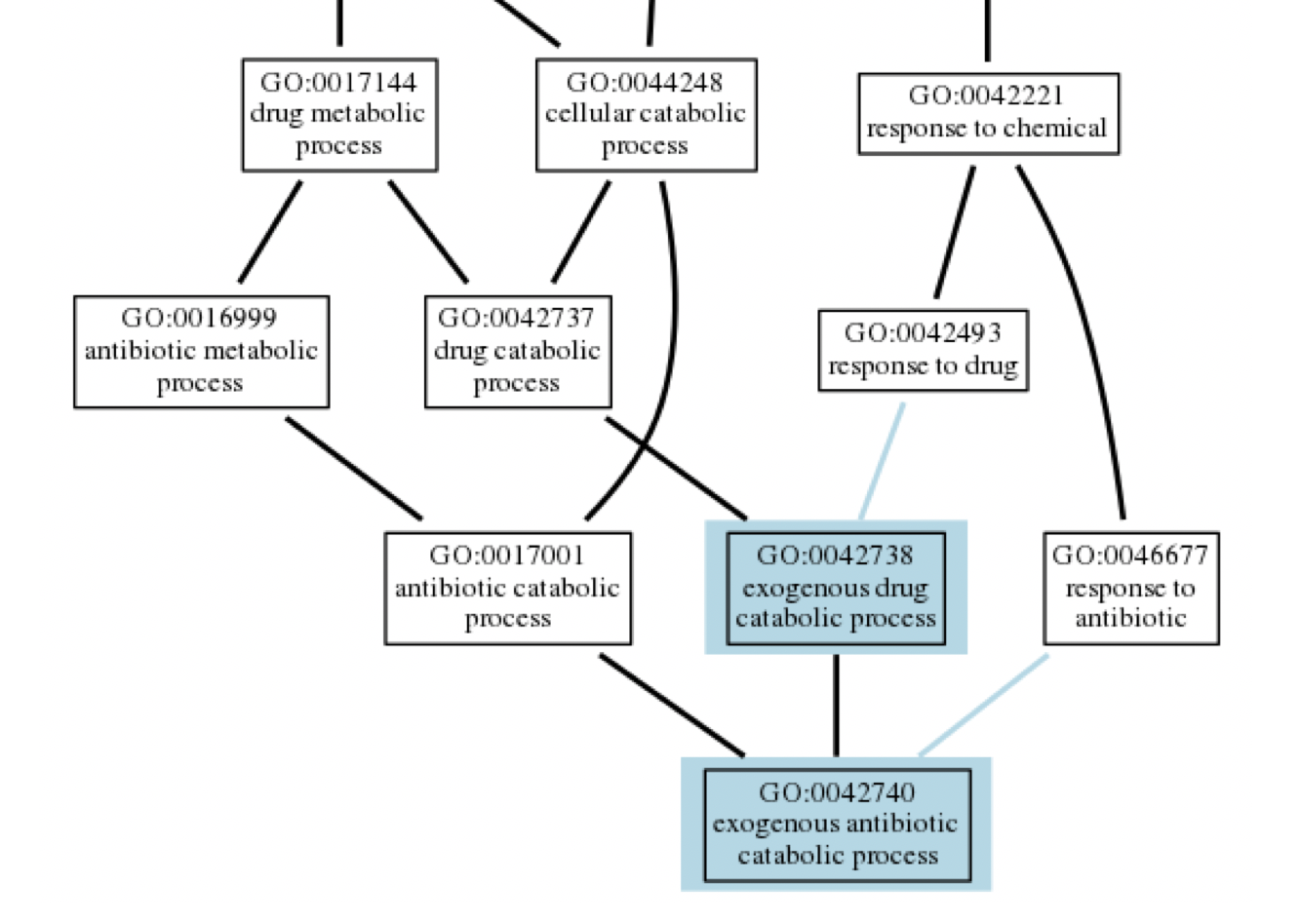

Step 2: measure sociality from genome content
2 – Annotation-based: annotated bacterial cooperative traits
Defined and structured gene products annotations
Measure of cooperativity: number of protein coding sequences annotated with a “social GO”
→ Establish list of “social GOs”
→ Annotate genomes with GOs
Look for ”social GOs”
PANZZER
Notes:
We assessed a microbe’s propensity for cooperation from their genome content

Slide 23
Step 2: measure sociality from genome content
2 – Annotation-based: annotated bacterial cooperative traits
Defined and structured gene products annotations
Notes:
We assessed a microbe’s propensity for cooperation from their genome content

Slide 24
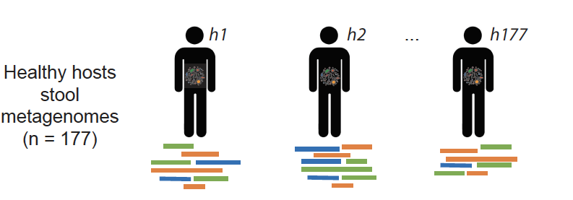
Relatedness
Secretome
Secr. machinery
Siderophores
Quorum sensing
Biofilm
Antibiotic deg.

Slide 25
Relatedness
Secretome
Secr. machinery
Siderophores
Quorum sensing
Biofilm
Antibiotic deg.

Slide 26
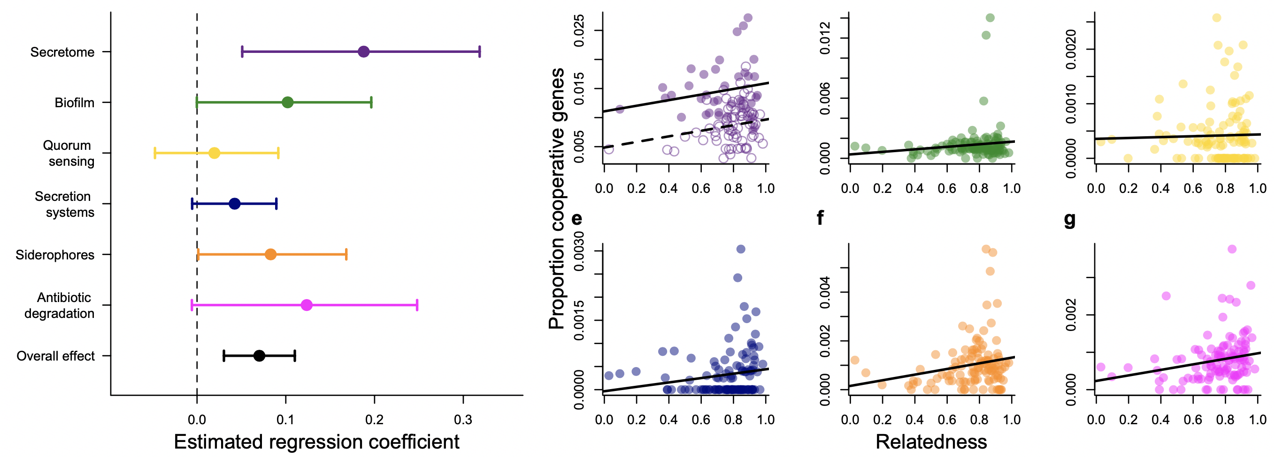

We find more genes coding for cooperative behaviours in species with higher relatedness
Proportional increase in number of coding genes dedicated to cooperation
${exp(β}_{ }^{ }) −1$ =
9.4%
Notes:
These results show that relatedness is predictive of the evolution of cooperation across the human gut microbiota, and this relationship appears to be general, holding over a wide range of species and ecologies. Moreover, while microbial cooperation has often been argued to be difficult to explain using kin selection theory ^{6,7}, our results show that the predictions of kin selection theory hold even in a system where the strict accuracy of the theory’s assumptions may break down. However, while relatedness is predictive of the evolution of cooperation, relatedness itself is likely a consequence of many aspects of organismal ecology, as supported by the large fraction of variance in relatedness explained by species ecology and phylogeny (Fig. 1d). We therefore sought to investigate which aspects of organismal ecology drive this positive assortment.

Slide 27
Relatedness → Cooperation
???? →
Explained
Idiosyncratic
Notes:
We then assessed the effects of both the relative abundance (group size) and sporulation scores (migration rate) of gut microbiota species on their within-host relatedness

Slide 28
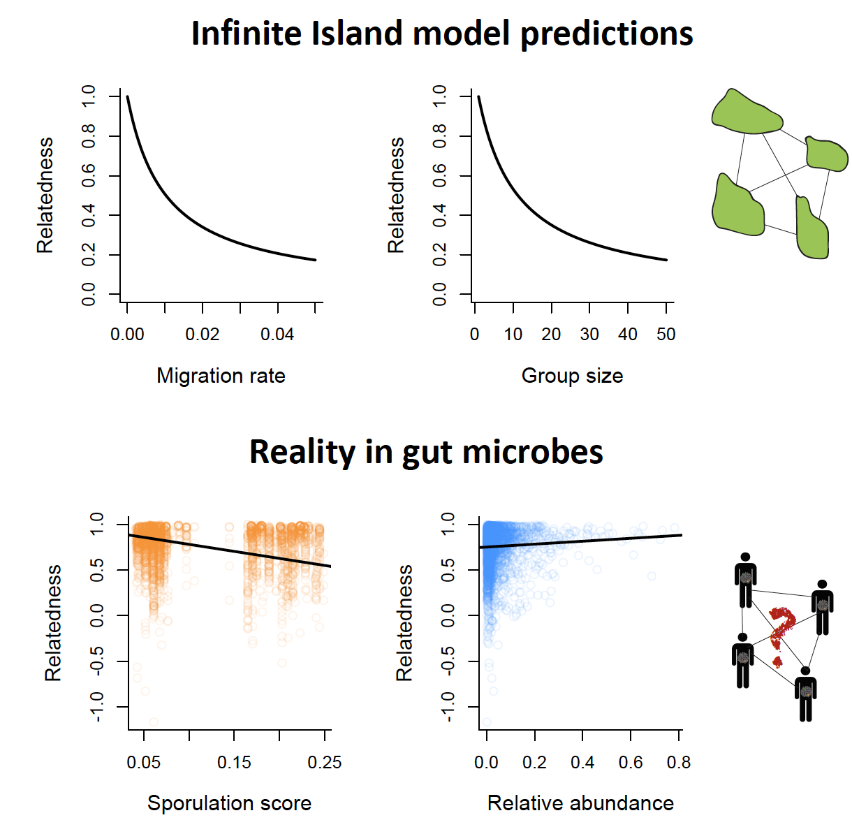
What are the ecological drivers of relatedness?
Notes:
- One possibility is that blooms of individual taxa in the microbiota are associated with genetic bottlenecks.
- the case if between and within species competitive abilities are positively correlated
- bacterial species that have higher relative abundance in the gut to be also more likely to be dominated by a single strain within the species
- or if strains that reach high abundance provoke a host immune response which clears competitor strains.

Slide 29
Conclusion
Relatedness is predictive of the evolution of cooperation across the human gut microbiota
Inclusive fitness theory is useful
Theory & assumptions holds even in the complex world
A simple population genetics parameter
Actionable tool
Notes:
The ultimate test of any general evolutionary theory is in its ability to explain patterns of trait evolution across taxa. Overall, our results strongly support Hamilton’s central prediction that relatedness drives the evolution of cooperation holds across the human gut microbiota, and reveal insights into the drivers of this key population genetic parameter. While debate continues over the exactness and assumptions of the inclusive fitness framework and kin selection models, it is clear that the central insight of Hamilton’s theory is general. In the case of human associated microbes, this is not only of importance for evolutionary biology but also for medicine, as microbes can have their largest effects on health when they cooperate to help or harm their host ^{12,55,56} . Hamiltonian medicine ^{21,57} – the manipulation of relatedness in our microbes – may offer opportunities to steer microbial cooperation in ways to enhance human health.

Slide 30
Using evolutionary theory to predict microbiome effect on host health

Slide 31
Using evolutionary approaches to help devising strategies to tackle AMR

Slide 32

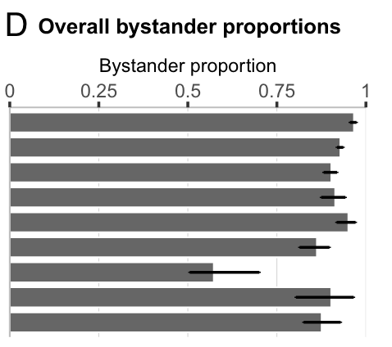
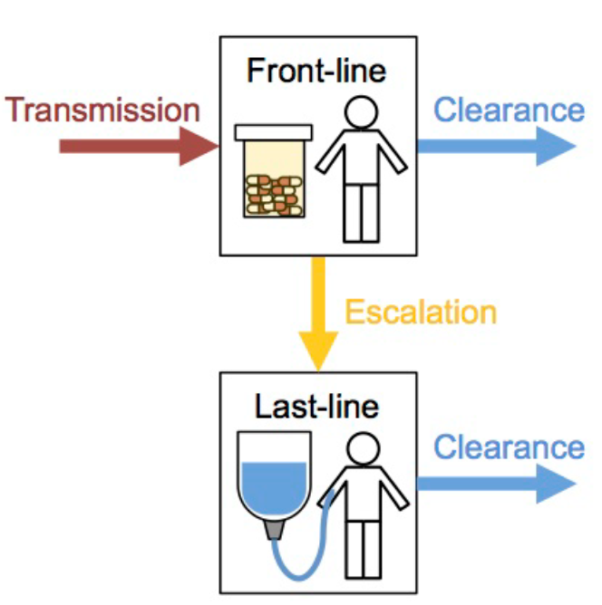
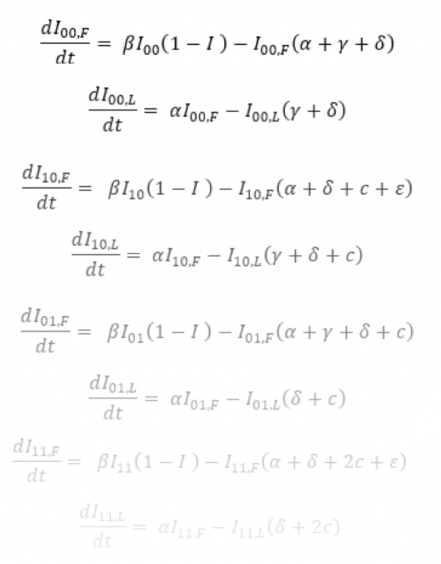

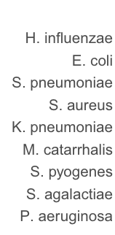
How?
Mathematical modelling
+ Public Health data
Answer
practical & strategic
questions
Capture essential features of a process
Model parametrization
& Quantitative results
Most effective strategy?
Best cost-benefit strategy?
Where to invest?
From Tedijanto et al., 2018

Slide 33
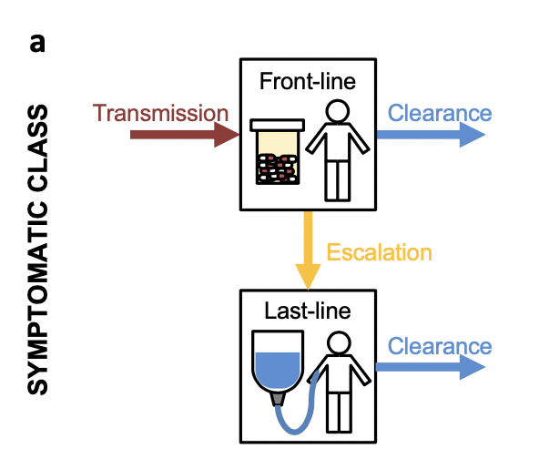
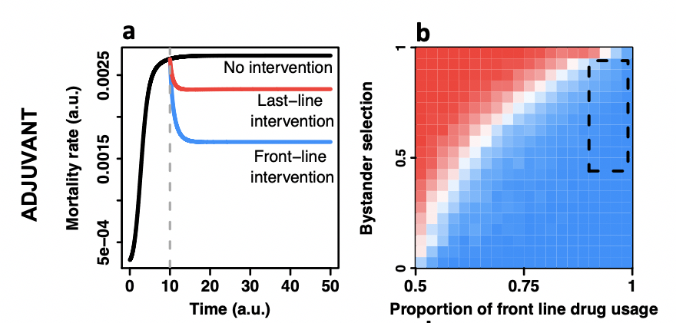
Focussing on resistance to front-line drugs is the most effective way to combat the antimicrobial resistance crisis

Slide 34



Antibiotic usage in animals contributes to the rise of resistance in Humans

Slide 35
Antibiotic usage in animals contributes to the rise of resistance in Humans
How should we change our AB practice in animals to benefit public health?

Slide 36

Antibiotic usage in animals contributes to the rise of resistance in Humans
?
How should we change our AB practice in animals to benefit public health?

Slide 37
Intuitively … reduce AB usage in animals?

Slide 38
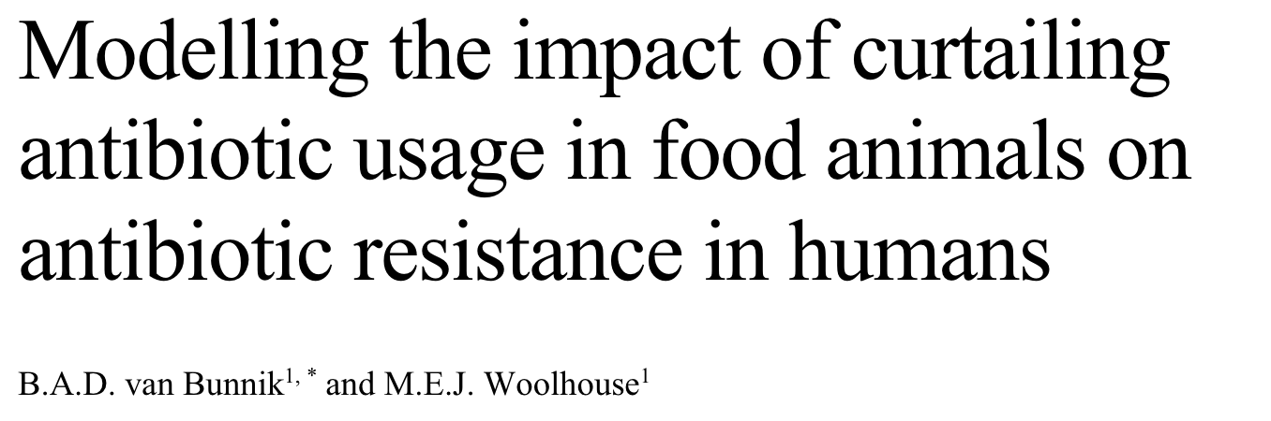
Intuitively … reduce AB usage in animals?
Antibiotic consumption by food animals
Levels of resistant bacterial infections in humans
<->

Slide 39
Intuitively … reduce AB usage in animals?
Antibiotic consumption by food animals
Levels of resistant bacterial infections in humans
<->
CONCLUSIONS
Little impact on resistance
Reduce rate of transmission instead
Response depend on H → A transmission too

Slide 40
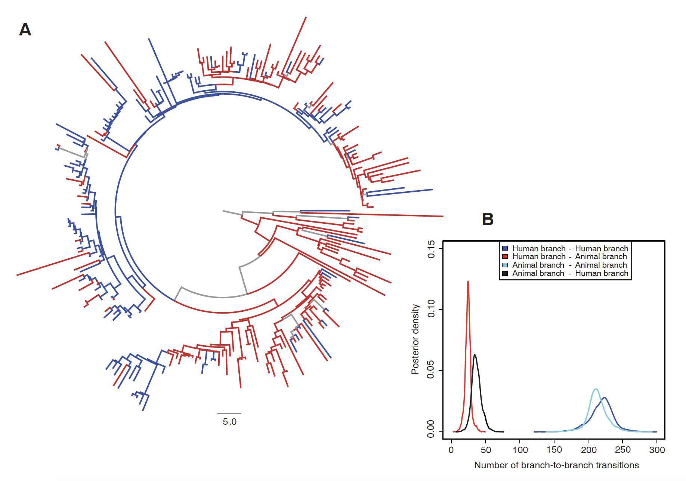
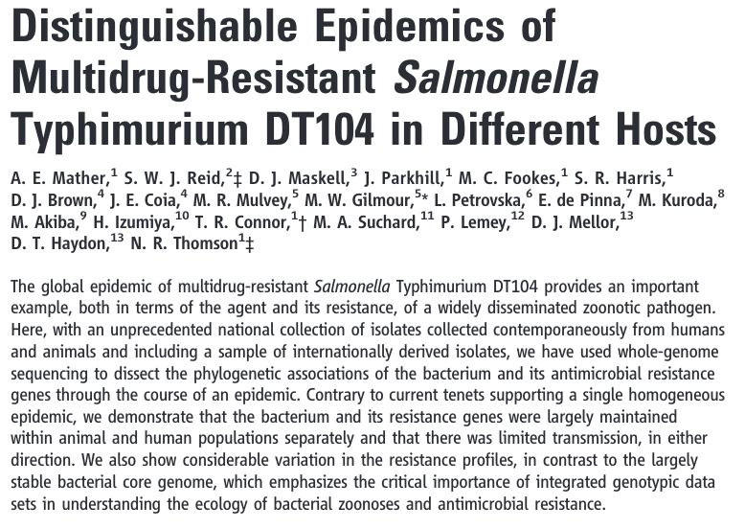
Is Animals – Human transmission a parameter we can improve much?

Slide 41
Reduced usage of AB in animals could even be detrimental for public health in certain scenario

Slide 42



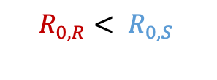

Reduced usage of AB in animals could even be detrimental for public health in certain scenario
$$R_{0,R}> R_{0,S}$$
$$R_{0,R}< R_{0,S}$$

Slide 43

Reduced usage of AB in animals could even be detrimental for public health in certain scenario
$$R_{0,R}> R_{0,S}$$
$$R_{0,R}< R_{0,S}$$

Slide 44
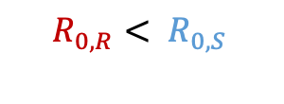
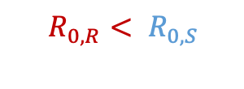
Reduced usage of AB in animals could even be detrimental for public health in certain scenario
$$R_{0,R}> R_{0,S}$$
$$R_{0,R}< R_{0,S}$$
$$R_{0,R}< R_{0,S}$$
$$R_{0,R}< R_{0,S}$$

Slide 45

Reduced usage of AB in animals could even be detrimental for public health in certain scenario
$$R_{0,R}> R_{0,S}$$
$$R_{0,R}< R_{0,S}$$
$$R_{0,R}< R_{0,S}$$
$$R_{0,R}< R_{0,S}$$

Slide 46
Reduced usage of AB in animals could even be detrimental for public health in certain scenario
$$R_{0,R}> R_{0,S}$$
$$R_{0,R}< R_{0,S}$$
$$R_{0,R}< R_{0,S}$$
$$R_{0,R}< R_{0,S}$$
Increased disease prevalence = negative public health effect

Slide 47



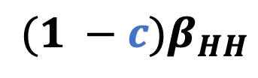



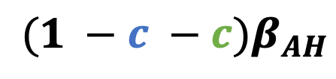
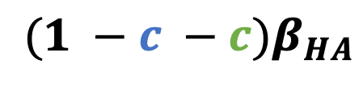

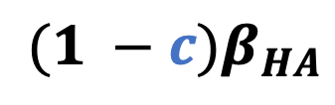


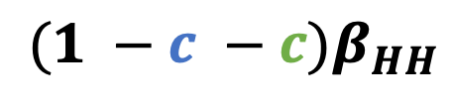



$${(1 −c −c)β}_{AA}$$
$${(1 −c −c)β}_{HH}$$
$${(1 −c)β}_{AA}$$
$${(1 −c)β}_{HH}$$
$${(1 −c −c)β}_{AH}$$
$${(1 −c)β}_{AH}$$
$${(1 −c)β}_{HA}$$
$${(1 −c −c)β}_{HA}$$
Sensitive
$$γ+ τδ+ τδ$$
$$γ+ τδ+ τδ$$
R:
$$γ+ τδ$$
$$γ+ τδ$$
R:
$$γ$$
$$γ+ τδ$$

Slide 48

Which drugs and how much they are used determine if reducing usage in animals benefits or not Human health.
Careful choice of which drugs we decide to intervene on
What is the real difference in drug usage in Animals and Humans
→ Parametrizing the model

Slide 49

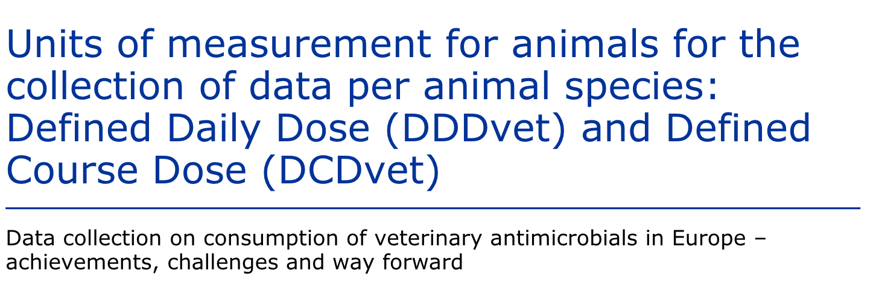
Parametrizing the model

Slide 50
Parametrizing the model
Protein synthesis
B-lactam (cell wall)
DNA
Other

Slide 51
Parametrizing the model
Many other parametrizing choices to do …
Species-specific
Country/Region
Accurate re-scaling of usage data
Cost of resistance
Baseline clearance
Drug induced clearance
Mutation/Conversion rate
Transmission
Resistance prevalence

Slide 52
Evolutionary microbiology to improve Human health
Framework to understand and predict microbial communities dynamics
Derive actionable tools for microbial communities management
Various aspects of Human & Public health
Link fundamental insights to strategic decisions
Camille Simonet

Slide 53
Acknowledgement
Luke McNally
Rosalind Allen (Soft condensed matter physics)
Deirdre McLean
Mark Woolhouse
Meghan Perry
Camille Simonet
Any question?

Slide 54
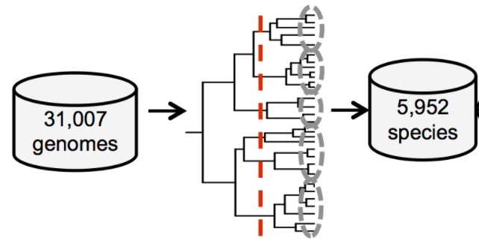
MIDAS pipeline
Species identification and abundance: species database (prebuilt)
Align reads to 15 universal single genes copy family
Species relative abundance
Species level cutoff
Genomes clusters

Slide 55
MIDAS pipeline
SNP calling: core genome database (with data)
Built one representative genome species: greatest nucleotide identity on average
→ Reads mapped to this
→ identify variants
Gene content: pan genome database (with data)
Database of all genes present across all species: any two genes <99%id classified distinct
→ Reads mapped to this
→ Gene content and Gene coverage per species

Slide 56
Methods: GO trait quantification
Social traits keywords
All bacterial GO
Biofilm formation
GO:00238
Biofilm
Siderophore
...
Keyword match
GO: 00332, drug metabolic process
GO: 00238, biofilm formation
GO: 00482, response to chemical
GO: 00384, Siderophores production
Extracellular matrix production
GO:00399
Cell-cell adhesion
GO:00467
Retrieve child terms
Social GO lists
GO: 00238, biofilm formation
GO: 00467, cell-cell adhesion
GO: 00399, extracellular matrix
…
5 well-known cooperative traits:
Biofilm formation
Quorum-sensing
Secretion systems
Siderophores
Antibiotic-degrading enzymes
GO: 00384, siderophores production
GO: 00268, pyoverdine uptake
GO:99783, pyochelin receptor
…

Slide 57
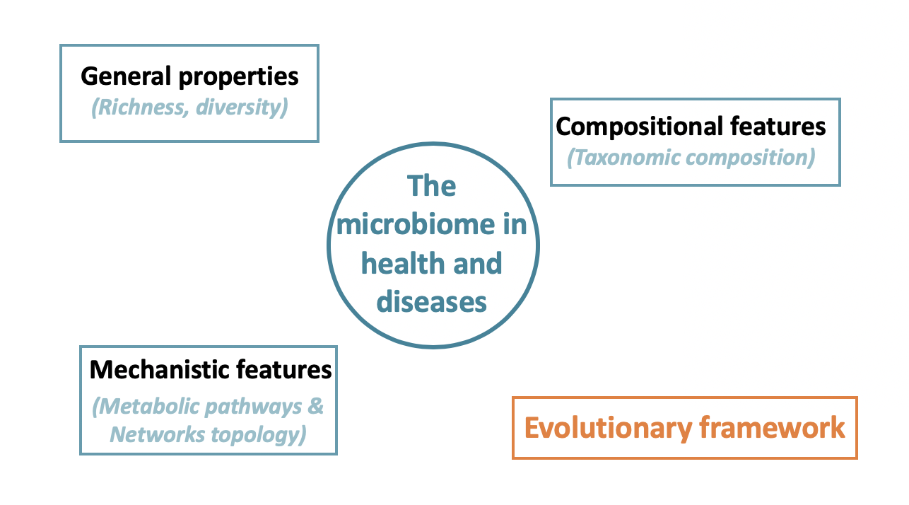
2
Using evolutionary theory to predict the effect of microbes on host health

Slide 58

What does evolutionary theory tell us about the microbiome-health relationship?
Theory predicts
Effect
Relatedness
→ magnitude
Relatedness
Vert. Trans.

Slide 59
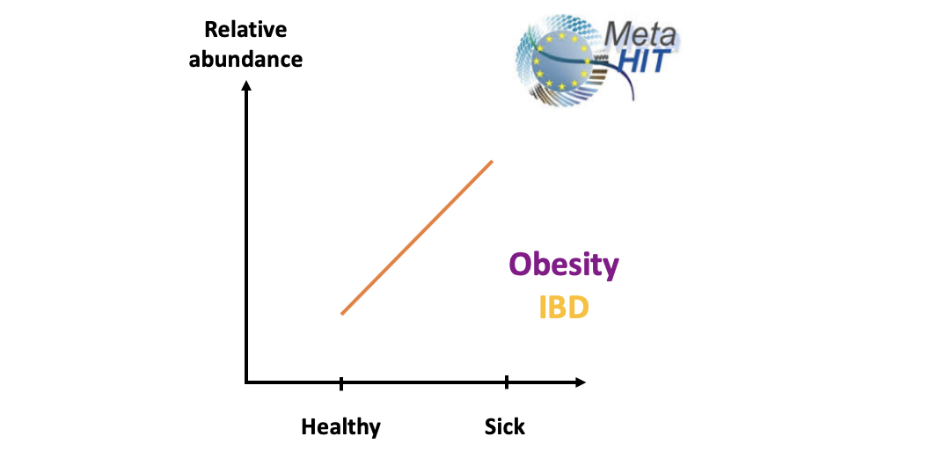
2
Testing prediction with real data: gut metagenomes
Relatedness
Health effect

Slide 60
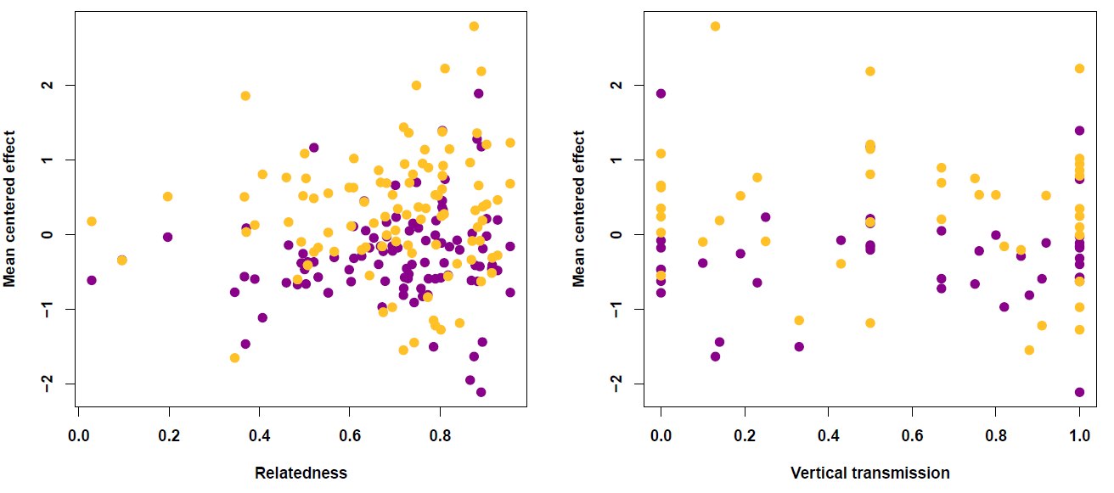
Testing prediction with real data: gut metagenomes
IBD
Obesity
Variances increases significantly a relatedness increases
(phylogenetic mixed model)

Slide 61

What does evolutionary theory tell us about the microbiome-health relationship?
Theory predicts
Data show
Relatedness → magnitude
Vertical transmission → direction
Effect
Candidate microbe approach
Generality
Microbes population genetics
Hamiltonian medicine
Relatedness
Vert. Trans.

